Slide 1
3. Overview of a PR System
Yong Peng
2020/03/10

Slide 2
Objective
Use the nearest neighbor to perform classification
Understand the limitations of nearest neighbor method
Understand and master the role, basic concepts and the categorization of solutions of each module of the pattern recognition system
Advanced objective
Put the KNN method into practice

Slide 3
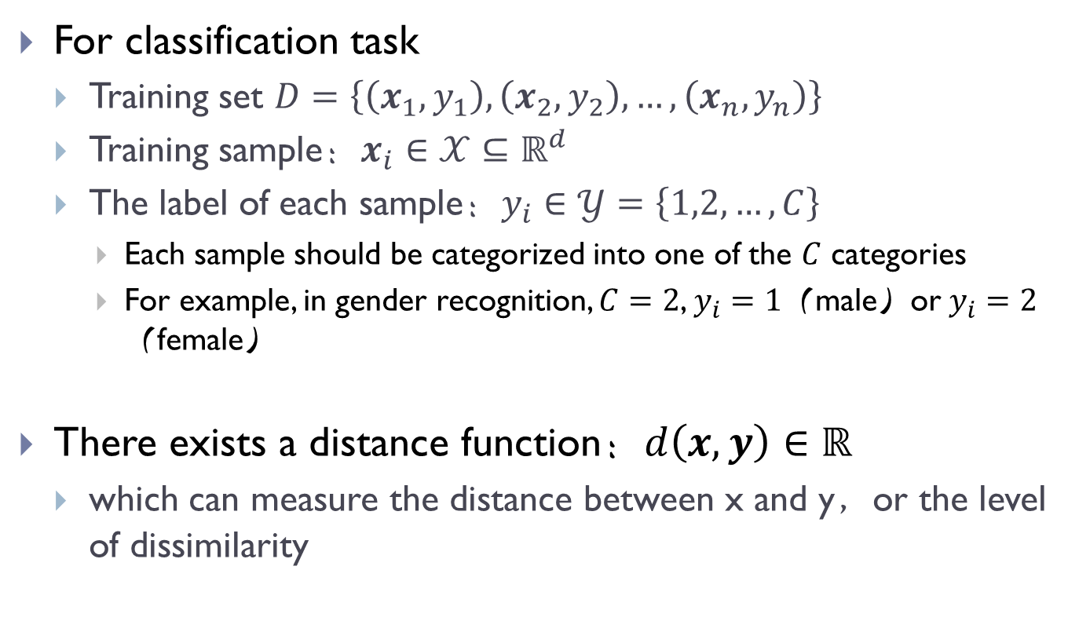
Nearest neighbor rule: problem setup
For classification task
Training set $D=\left\{\left(x_{1},y_{1}\right),\left(x_{2},y_{2}\right),…,\left(x_{n},y_{n}\right)\right\}$
Training sample：$x_{i}∈𝒳⊆ℝ^{d}$
The label of each sample：$y_{i}∈𝒴=\left\{1,2,…,C\right\}$
Each sample should be categorized into one of the $C$ categories
For example, in gender recognition, $C=2$, $y_{i}=1$（male）or$y_{i}=2$（female）
There exists a distance function：$d\left(x,y\right)∈ℝ$
which can measure the distance between x and y，or the level of dissimilarity

Slide 4
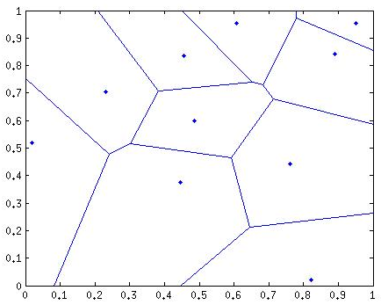

Nearest neighbor rule & Voronoi graph
Given a test sample $x$
1. identify its nearest neighbor $i^{∗}=\underset{i}{argmin}{d(x,x_{i})}$
2. output the prediction of $x$: $y_{i^{∗}}$
Voronoi diagram

Slide 5
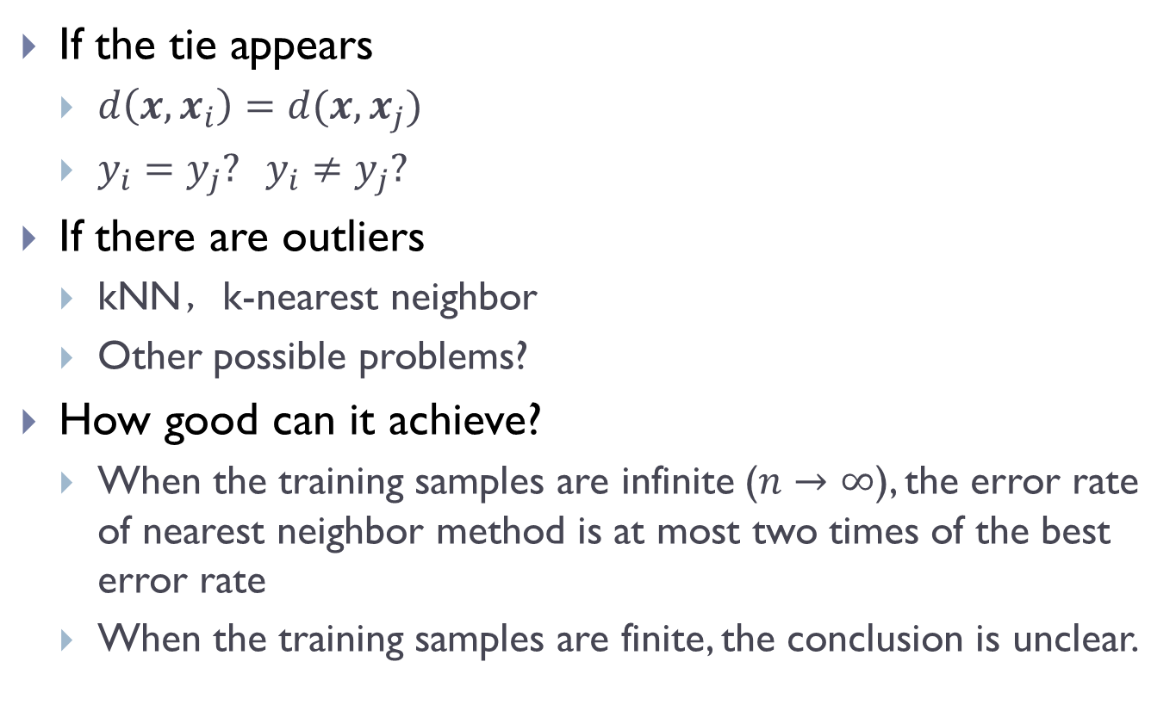
Discussion on nearest neighbor rule
If the tie appears
$d\left(x,x_{i}\right)=d(x,x_{j})$
$y_{i}=y_{j}? y_{i}≠y_{j}?$
If there are outliers
kNN，k-nearest neighbor
Other possible problems?
How good can it achieve?
When the training samples are infinite ($n→∞$), the error rate of nearest neighbor method is at most two times of the best error rate
When the training samples are finite, the conclusion is unclear.

Slide 6
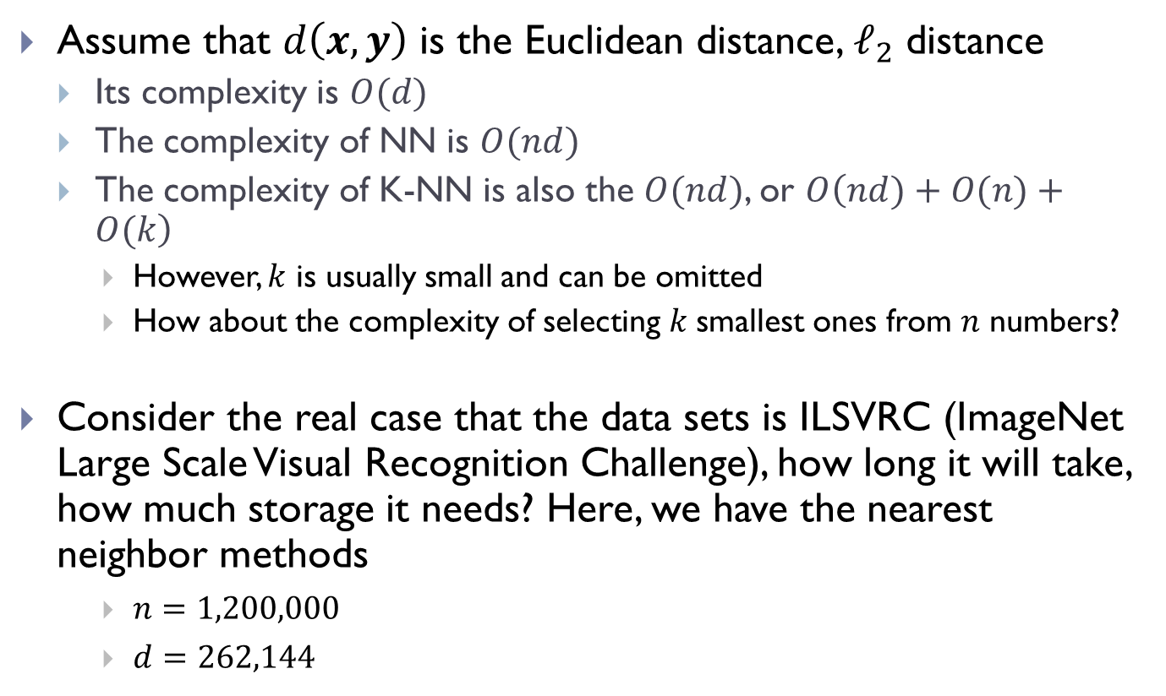
Computing and storage cost
Assume that $d\left(x,y\right)$ is the Euclidean distance, $ℓ_{2}$ distance
Its complexity is $O(d)$
The complexity of NN is $O(nd)$
The complexity of K-NN is also the $O(nd)$, or $O\left(nd)+O(n)+O(k\right)$
However, $k$ is usually small and can be omitted
How about the complexity of selecting $k$smallest ones from $n$ numbers?
Consider the real case that the data sets is ILSVRC (ImageNet Large Scale Visual Recognition Challenge), how long it will take, how much storage it needs? Here, we have the nearest neighbor methods
$n=1,200,000$
$d=262,144$

Slide 7
How to reduce?
Approximate nearest neighbor，ANN
Reading material: approximate nearest neighbor
https://apacheignite.readme.io/docs/ann-approximate-nearest-neighbor
Binary Hashing
Reading material: Binary Hashing for Approximate Nearest Neighbor Search on Big Data: A Survey
https://ieeexplore.ieee.org/document/8170203

Slide 8
The ugly details
Noisy sensing data.
Either training or testing or both data are subject to the effects of various internal and external noises.
Example: a drop of water on the camera lens….
Noisy or wrong labels.
The labels associated with training samples are noisy, in other words, the feature vector does not essentially correspond to its label
Example: medical CT image …
Uncontrolled environment
Laboratory conditions vs. uncontrolled outside environments

Slide 9
The ugly details
Improper pre-processing
Example: if the dimension of testing samples is different from that of training samples, how can we calculate the distance between them??
The existence of a semantic gap.
The numeric description and comparison of images are often far away from their meanings.
Example: face image to a machine → just values
Improper or failed feature extraction.
Feature extraction is the central step in PR system
Deep learning methods are usually end-to-end learning
Hand-crafted feature vs. feature learning from raw data

Slide 10
The ugly details
Mismatch between data and algorithm.
Select (design) proper algorithms for your specified data
Experience is often important.
Thirst for resources.
How can we scale our algorithms in dealing with big data?
Or how can we run our algorithm in limited resources.
Improper objectives.
Accuracy? Running speed? System price?
In most cases, we should make a balance among them because there is usually no system to satisfy all of them.

Slide 11
The ugly details
Improper post-processing or decision.
Prediction is the final step of a PR or ML algorithm, but not the PR systems.
Decision should be made based on such prediction, and then react to the environment according to the decision.
Improper evaluation.
Usually but not always, accuracy is a valid metric.
Example: consider the case you have a training set consisting samples from two classes, in which one class has 990 samples and the other has only 10 samples. ➔ imbalance
Even if you neglect the 10 sample, you will get 99% accuracy; however, it is meaningless.

Slide 12
How can we do in real cases?
As mentioned above, the performance of a learning or recognition system is determined by many factors.
How can we do?
Answer: make appropriate assumptions and simplifications
Example:
Engineering the environment vs. designing sophisticated algorithms.
Which one would you like to choose?
Gadget A: ……
Gadget B:…….

Slide 13
Example
Two face recognition based attendance recording gadgets.
Gadget A: allow a user to record attendance at any position around the gadget and use sophisticated face detection and face alignment techniques to correctly find and match the face.
High-tech, require many sub-systems and use many computing resources
Gadget B: require a sign on the ground at a fixed location in front of it and require all users to stand on the sign and look toward the gadget.
Might have higher recognition accuracy than gadget A because its raw input data is captured in a well-controlled situation.

Slide 14
Assumptions and simplifications
There are some common assumptions and simplifications to rest of the chapters.
The input data are free of noise or other types of errors.
The quality of the raw input data is, however, arguably the most importance single factor, and is beyond the control of the learning algorithm.
We assume that the labels for both training and testing samples are noise and error-free.
The ground-truth and predicted labels in a specific task belong to the same set.

Slide 15
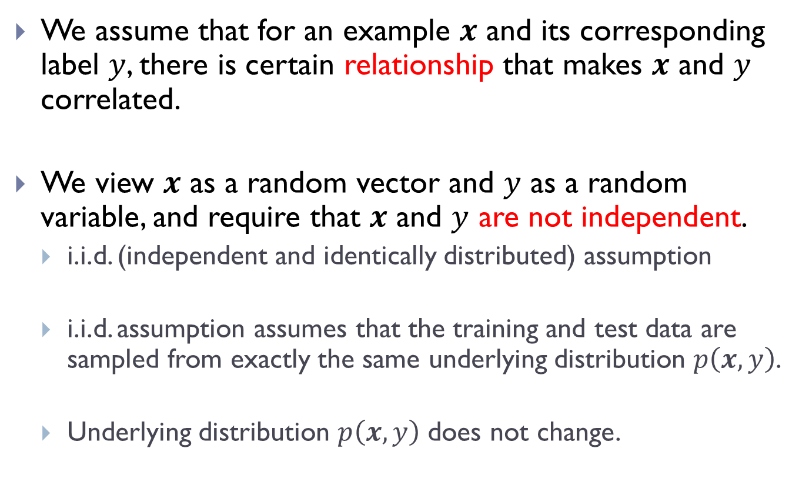
Assumptions and simplifications
We assume that for an example $x$ and its corresponding label $y$, there is certain relationship that makes $x$ and $y$ correlated.
We view $x$ as a random vector and $y$ as a random variable, and require that $x$ and $y$ are not independent.
i.i.d. (independent and identically distributed) assumption
i.i.d. assumption assumes that the training and test data are sampled from exactly the same underlying distribution $p\left(x,y\right)$.
Underlying distribution $p\left(x,y\right)$ does not change.

Slide 16
Assumptions and simplifications
We will introduce 3 types of preprocessing techniques
Principal component analysis (PCA) – unsupervised
Normalization of features, which helps when the different dimensions in an example’s feature vector have different scales
Fisher’s Linear Discriminant (FLD) – supervised
Given the input data and labels, feature extraction module is the most important for achieving highly accurate recognition results.
Classical approach: handcrafted features, domain expert’s knowledge involved
Advanced approach: feature learning from raw data, which is usually performed by a deep neural net (end-to-end)

Slide 17
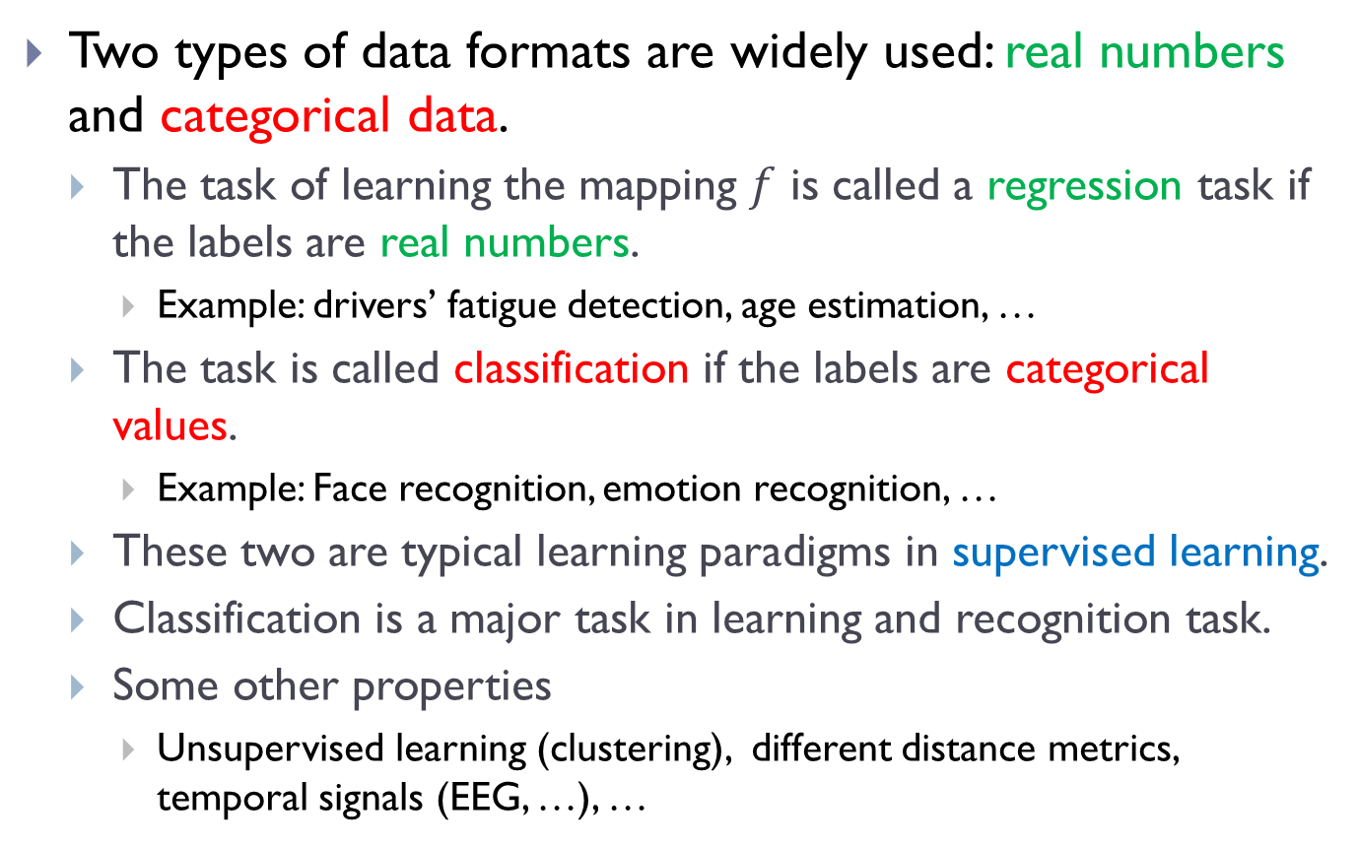
Assumptions and simplifications
Two types of data formats are widely used: real numbers and categorical data.
The task of learning the mapping $f$ is called a regression task if the labels are real numbers.
Example: drivers’ fatigue detection, age estimation, …
The task is called classification if the labels are categorical values.
Example: Face recognition, emotion recognition, …
These two are typical learning paradigms in supervised learning.
Classification is a major task in learning and recognition task.
Some other properties
Unsupervised learning (clustering), different distance metrics, temporal signals (EEG, …), …

Slide 18
A typical PR framework
Example:
The nearest neighbor search algorithm to face verification
Typical steps:
Know your problem
Make assumptions and formalize your problem
Come up with a good idea
Formalize the idea
Start from the simple case
Solve it
Apply these steps to understand the algorithms in this course.

Slide 19
homework1
Two simple derivations.
See attached .doc file for details.

